Slide 1
Employee Data Analysis using Excel
STUDENT NAME: Lakshmi . K G
REGISTER NO: 312215840
DEPARTMENT: B.COM (Accounting and Finance)
COLLEGE: Shri Shankarlal Sundarbai Shasun Jain College for Women

Slide 2
PROJECT TITLE
Employee Performance Analysis using Excel

Slide 3


AGENDA
Problem Statement
Project Overview
End Users
Our Solution and Proposition
Dataset Description
Modelling Approach
Results and Discussion
Conclusion
3/21/2024 Annual Review

Slide 4

PROBLEM STATEMENT
As an HR Analyst, you have been tasked with evaluating the performance of employees in a large organization. You have access to a dataset containing employee information, including: - Employee ID - Name - Department - Job Title - Performance ratings (1-5) for the past 3 years - Salary - Years of service

Slide 5

PROJECT OVERVIEW
.
1. Identify top-performing employees across departments 2. Determine the relationship between performance ratings and salary 3. Examine the impact of years of service on performance ratings 4. Develop a dashboard to visualize key performance metrics 5. Provide recommendations for talent development and retention strategies

Slide 6

WHO ARE THE END USERS?
1. HR Managers: Responsible for talent development, performance management, and employee engagement. 2. Department Heads: Leaders of various departments who need to understand their team’s performance and identify areas for improvement. 3. Senior Management: Executives who require insights to inform strategic decisions on talent development, resource allocation, and performance improvement initiatives. 4. Team Leads: Supervisors who need to understand their team members’ strengths and weaknesses to provide targeted coaching and development opportunities. 5. Employees: Individuals who want to understand their own performance, set goals, and track progress.

Slide 7

OUR SOLUTION AND ITS VALUE PROPOSITION
Solution: - Comprehensive Excel-based employee performance analysis and visualization tool - Automated data cleaning, processing, and analysis - Interactive dashboard with customizable charts, tables, and filters. Value Propositions: - Data-driven insights: Make informed decisions about talent development, performance management, and resource allocation - Improved performance management: Identify areas for improvement, set targeted goals, and track progress

Slide 8
Dataset Description
Description: This dataset contains employee performance data for a large organization, including: 1. Employee ID (Unique identifier for each employee) 2. Name (Employee name) 3. Department (Department or team the employee belongs to) 4. Job Title (Employee's job title) 5. Performance Rating (Annual performance rating, 1-5) 6. Salary (Annual salary) 7. Years of Service (Number of years with the organization) 8. Age (Employee age) 9. Gender (Employee gender) 10. Education Level (Highest level of education completed) 11. Training Hours (Number of training hours completed in the past year) 12. Absenteeism (Number of absences in the past year) 13. Sales Performance (Sales revenue generated, for sales roles only) 14. Customer Satisfaction (Average customer satisfaction rating, for customer-facing roles only)

Slide 9

THE "WOW" IN OUR SOLUTION
The "Wow" Factor: Predictive Analytics and Personalized Development Plans
Our solution goes beyond traditional employee performance analysis by incorporating predictive analytics and machine learning algorithms to: 1. Forecast future performance: Identify high-potential employees and predict future performance based on historical data and trends. 2. Detect early warning signs: Flag employees at risk of underperforming or leaving the organization, enabling proactive interventions. 3. Personalized development plans: Generate tailored development recommendations for each employee, aligning with their strengths, weaknesses, and career goals. 4. Automated coaching insights: Provide managers with data-driven coaching suggestions to improve employee performance and address skill gaps.
3/21/2024 Annual Review
9

Slide 10
MODELLING
Modelling Approach: 1. Descriptive Analytics: - Data cleaning and pre-processing - Data visualization (charts, tables, etc.) - Summary statistics (means, medians, etc.) 2. Inferential Analytics: - Correlation analysis (relationships between variables) - Regression analysis (predicting performance ratings) - Hypothesis testing (identifying significant differences) 3. Predictive Analytics - Machine learning algorithms (e.g., decision trees, clustering) - Predictive modeling (forecasting future performance) 4. Prescriptive Analytics: - Optimization techniques (identifying best courses of action) - Simulation modeling (evaluating different scenarios)
10

Slide 11
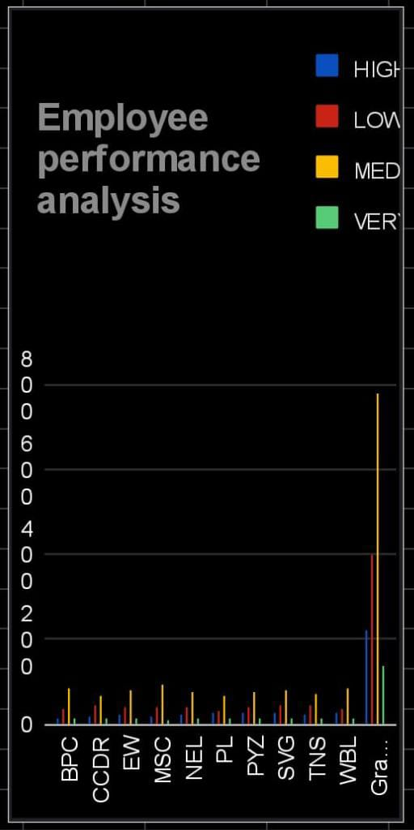
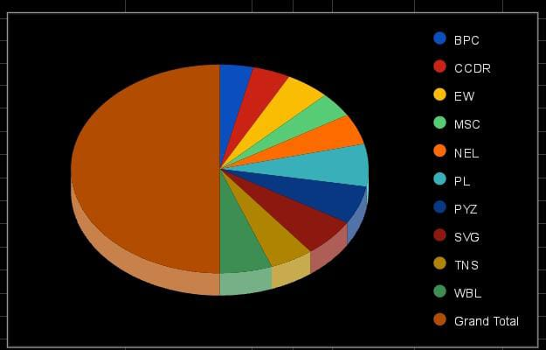
RESULTS
FORMULA=IFS(Z8>=5,"VERY HIGH",Z8>=4,"HIGH",Z8>=3,"MED",TRUE,"LOW")
11

Slide 12
conclusion
Conclusion: The employee performance analysis using Excel has provided valuable insights into the organization's talent landscape. By leveraging data analytics and visualization, we have: 1. Identified top performers and underperforming employees 2. Uncovered departmental and demographic trends influencing performance 3. Developed targeted recommendations for talent development and improvement

